Slide 1


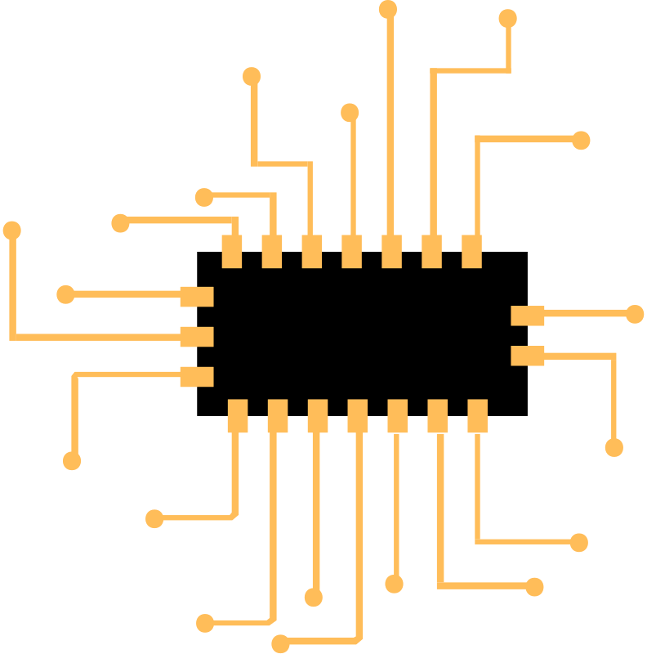
Star Tech
HAND GESTURE CONTROL APP

Slide 2


About Us
Team Leader:
Soujannya Deb
Roll-CSE(DS)/20/39
Member 1:
Aftab Mallick
Roll-CSE(DS)/20/60
Member 2:
Abhinaba Sarkar
Roll-CSE(DS)/20/47

Slide 3
Objective
Hand Gesture Recognition for Improved Human-Computer Interaction: The objective is to develop an application that utilizes hand gestures as an alternative input method for controlling a laptop.
Efficiency and Convenience: With this innovative solution, you can perform basic tasks on your computer, such as controlling media playback, navigating a slideshow, and scrolling web pages, without the need for traditional input devices such as a keyboard or mouse.
Advancing the User Interface: This project aims to promote a more intuitive and user-friendly interface by incorporating advanced gesture recognition technology into everyday computing.

Slide 4
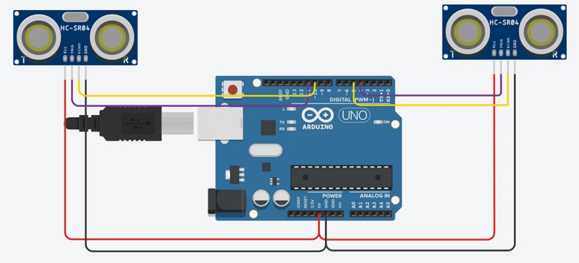
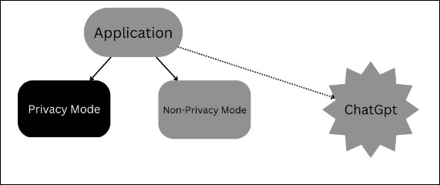

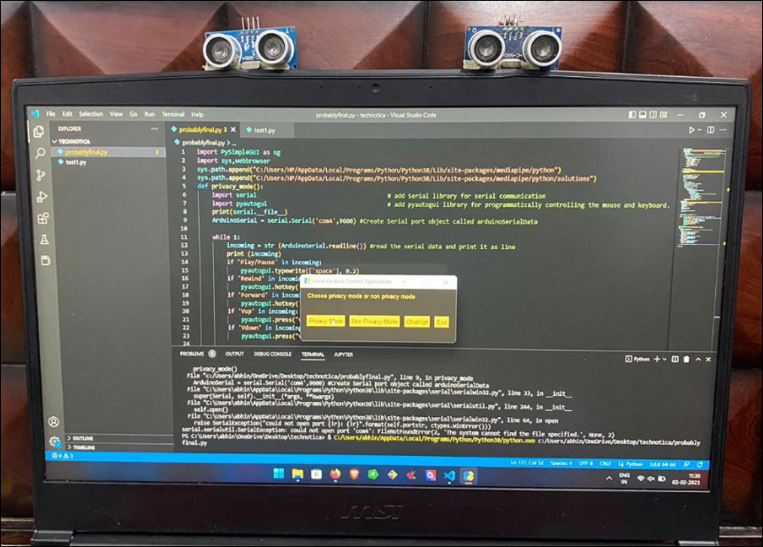
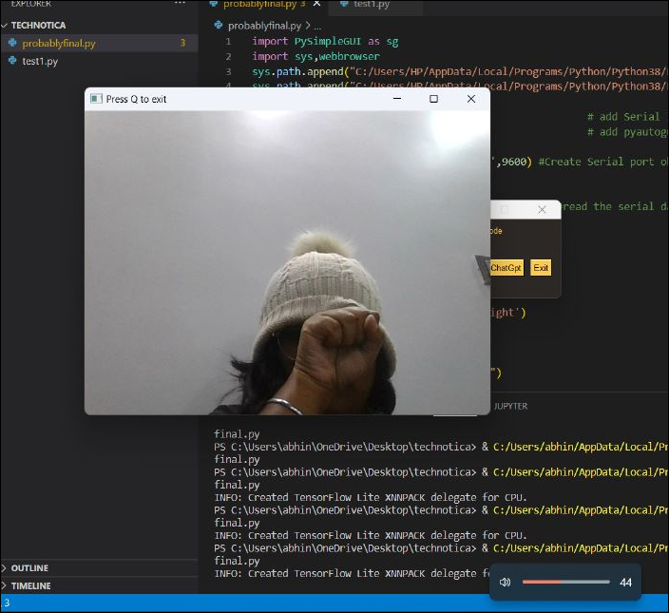
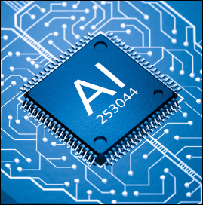

Circuit diagram of system
Our Solutions
Flowchart

Slide 5
Privacy Mode
The project leverages the capability of two ultrasonic sensors (HC-SR04) and the technology of Arduino and Python to create a simple and effective solution.
2. The sensors are placed on top of a laptop screen, measuring the distance between the hand and the sensor, and the information is sent to Python through the serial port.
3. Python then reads the information and performs the designated actions, providing an alternative method of controlling a computer without traditional input devices.

Slide 6
Non Privacy Mode
Gesture recognition uses camera and computer vision tools to identify and process human gestures as inputs.
The technology requires a webcam or built-in camera, and a functional computer, along with computer vision tools such as OpenCV and a media pipeline for recognition.

Slide 7
Virtual Assistant
A virtual assistant is a software program designed to perform tasks for a user, such as scheduling appointments, sending emails, and providing information.
Virtual assistants use natural language processing (NLP) and machine learning algorithms to understand and respond to user requests, allowing for human-like interaction.

Slide 8
Gesture recognition technology processes non-verbal information from humans for various applications.
APPLICATIONS
Improved Gaming: Gesture recognition enhances the gaming experience by allowing control of gaming consoles through gestures.
Versatile Input: Facial gesture recognition provides precise control and serves as an alternative to traditional input devices, allowing for control through gestures and speech recognition.
Convenient Control: Gesture recognition technology can also be applied to control medical devices and household appliances through hand gestures.

Slide 9
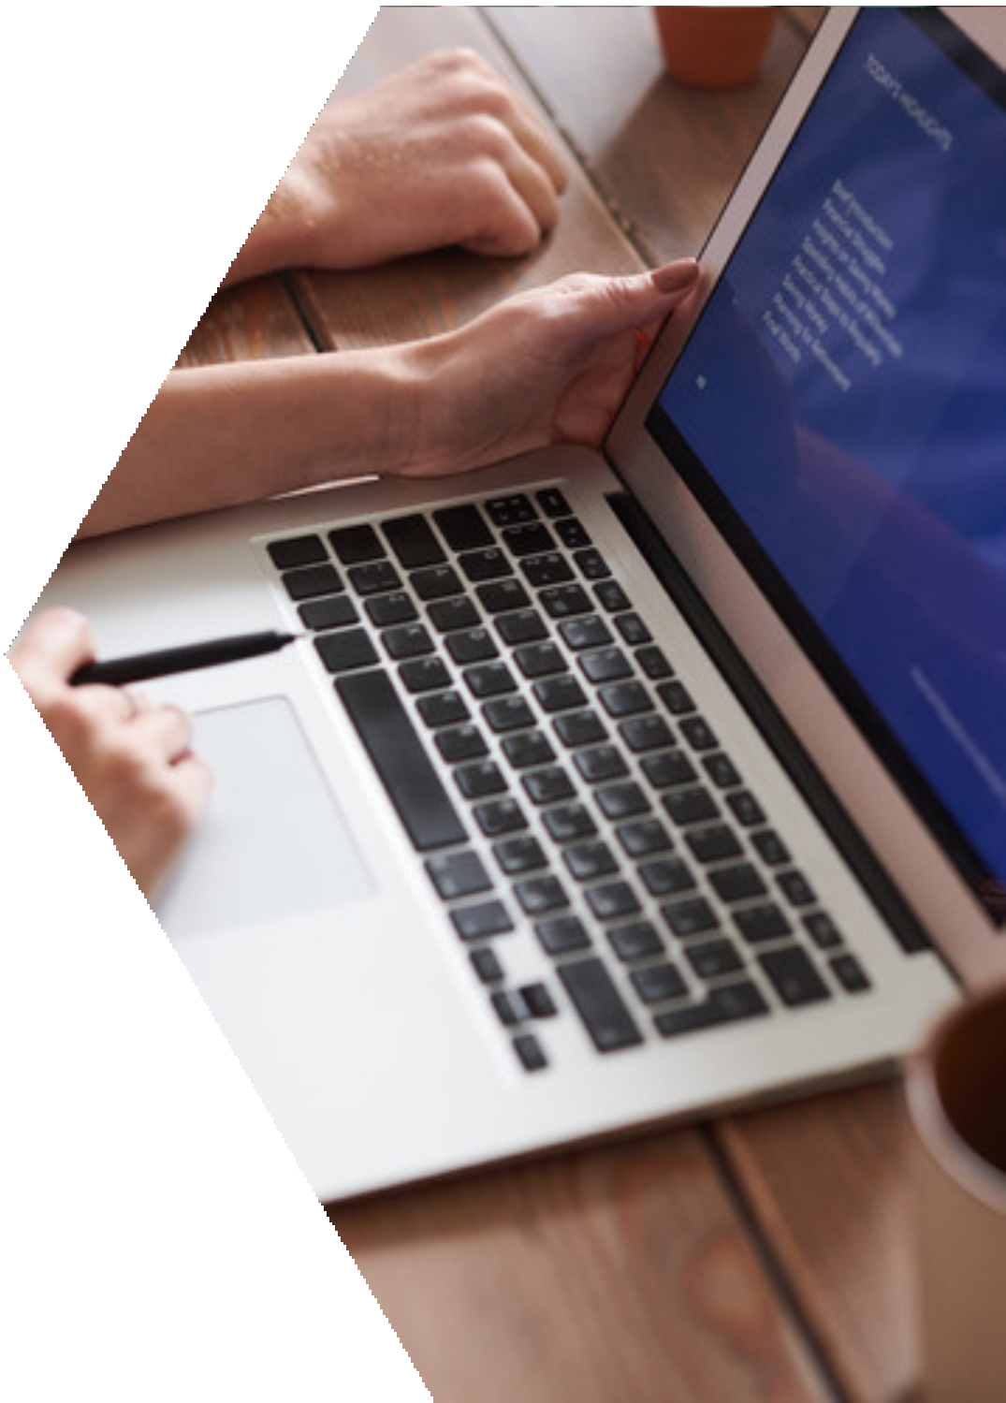
REFERENCES
R. Mukherjee, P. Swethen, R. Pasha, and S. Singh Rawat. "Hand Gesture Controlled Laptop Using Arduino." International Journal of Management, Technology, and Engineering, vol. 8, pp. 1037-1043, Oct. 2018.

Slide 10
THANK YOU

